Slide 1
West Nile Virus
Alex Celis, Erik Green, Jordan Nelson
Data Scientists, Team Citronella

Slide 2
Agenda
Project Goal
Gathering Data & Cleaning
Exploring the Data
Model Selection & Evaluation
Model Prediction
Cost Benefit Analysis
Project Next Steps

Slide 3
Project Goal
Where is West Nile Virus found?
Where are mosquitoes most frequent?
Can we predict where West Nile Virus will occur?
How has pesticide spraying effected mosquito populations?
How has pesticide spraying affected West Nile Virus?
How could we improve our prevention of West Nile Virus?

Slide 4
Gathering & Cleaning Data
Mosquito Trap Data
NOAA Weather Data
Spray Records Data
Notes:
We have 3 data sources; we merged this together into one dataframe of features so we could see how we these affect wnvirus

Slide 5
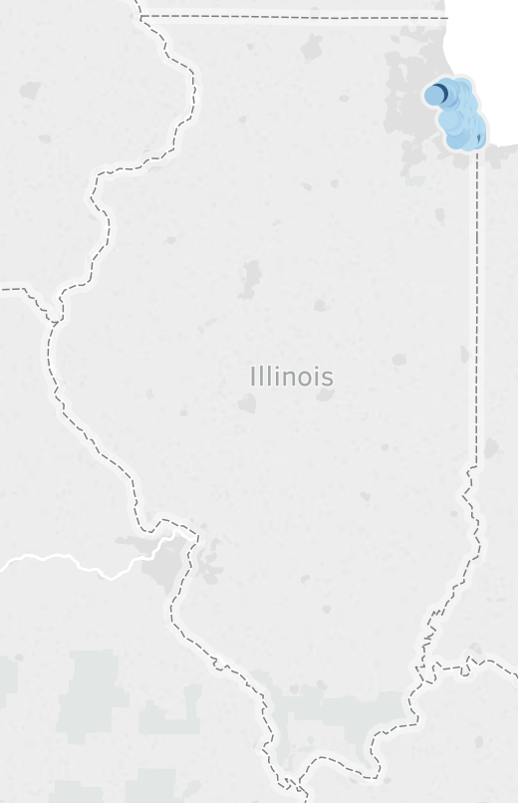
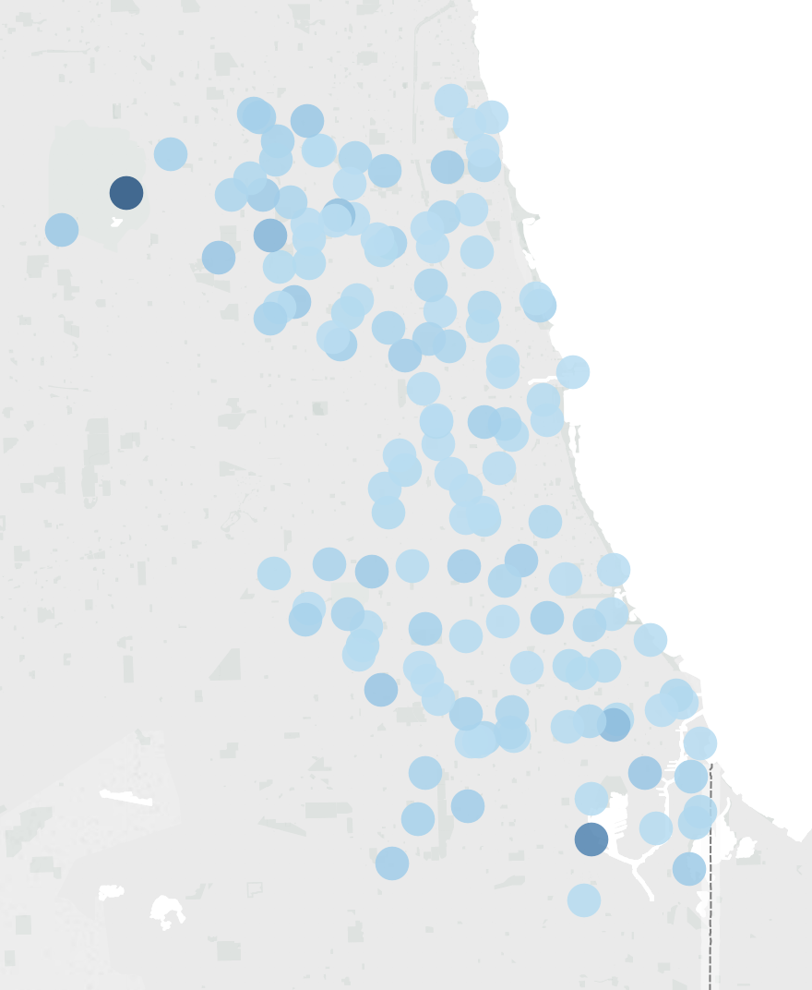
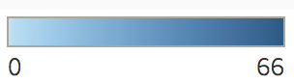
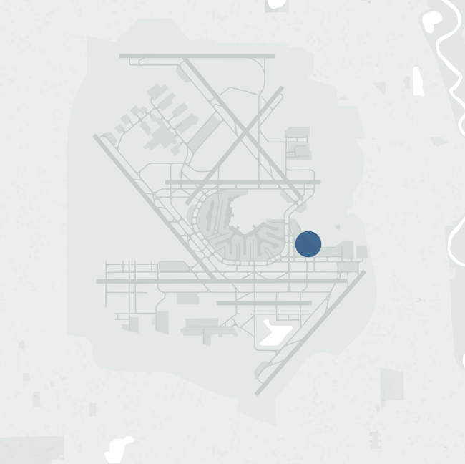
Exploring:
Where is West Nile?
Total Amount
of West Nile Virus
(2007, 2009, 2011, 2013)
Notes:
This graphic displays all of the mosquito traps in Chicago, colored by the frequency of times that mosquitos were infected with West Nile.

Slide 6
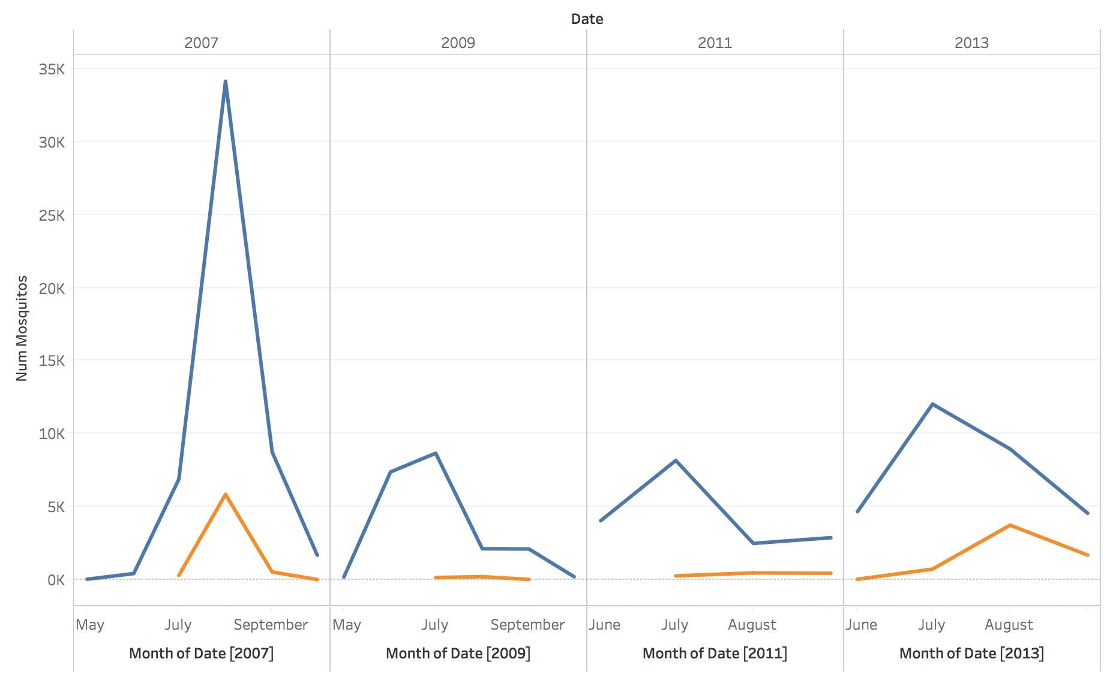
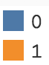
Exploring: How do mosquitos effect West Nile?
Presence of West Nile Virus by Mosquito Frequency
Notes:
As mosquitos increase the frequency of West Nile Virus also increases. In order to combat West Nile virus we will need to combat the amount of mosquitos. Historically, in Chicago this has been done via spraying.

Slide 7
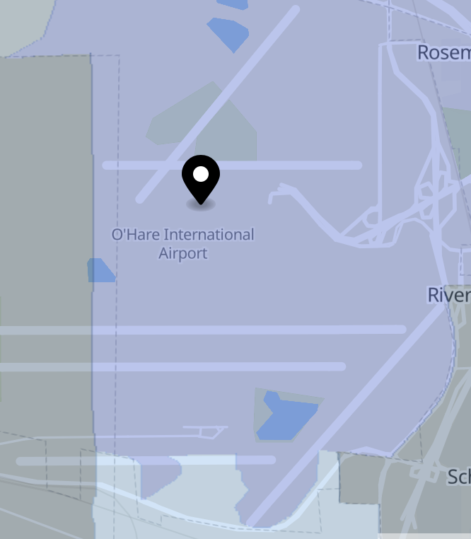
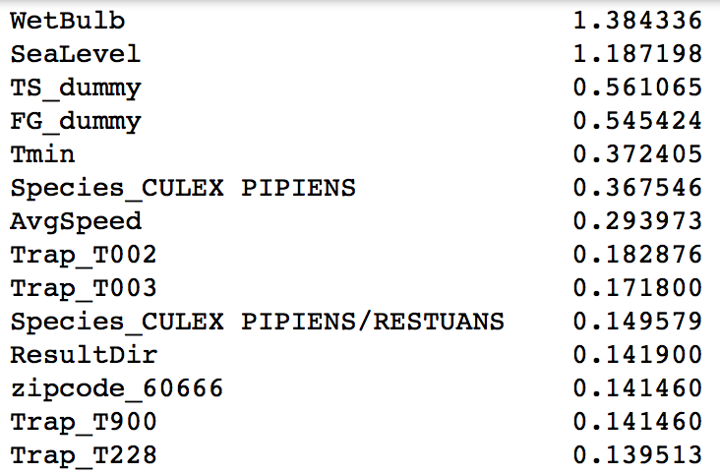
Modeling West Nile:
Logistic Regression
ROC-AUC Score: .81
Weather
Location
Species
Zipcode & Trap
Notes:
Looking at this we can identify the characteristics of areas that breed west nile virus:
Wetbulb is a measure of humidity
SeaLevel plays a major
TS, Thunderstorms
FG, Fog
Tmin -
Mosq Species: Culex
Wind Speed
Result Dir - Direction of the wind
- We ran this model with and without the frequency of sprays and it didn’t vastly improve our ROC-AUC score. Anecdotally this led us to believe that maybe how frequently something was being sprayed, didn’t affect the WNV cases.

Slide 8
Cost-Benefit Analysis
Cost of Spray
Is Spray Effective?
Side-Effects of Spray
Alternatives to Spray

Slide 9

Cost-Benefit Analysis: Cost of Spray
0.67 cents per acre
149,760 acres of Chicago
1 sprays
Estimated Total Cost = $100,340

Slide 10
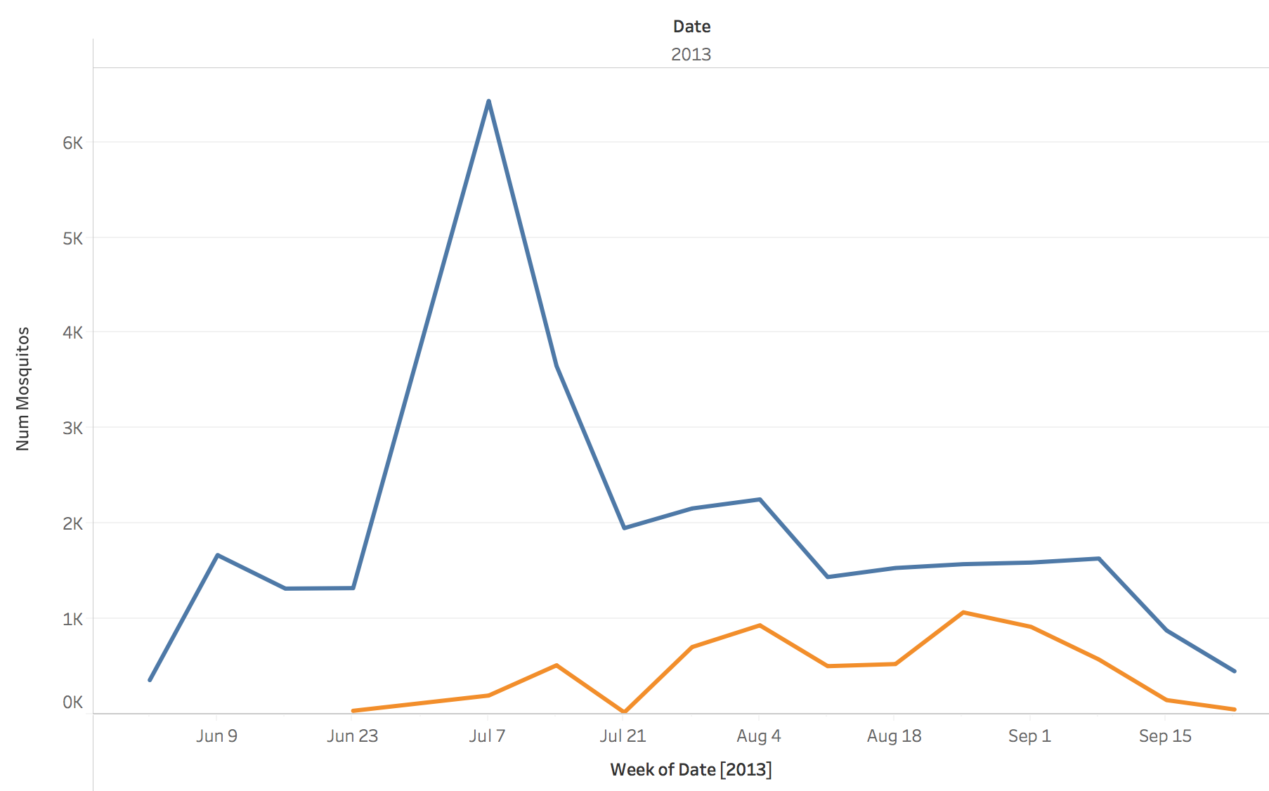
Cost-Benefits: Impacts of Spray on Mosquito Frequency
Notes:
Spraying occurred on July 17th, July 25th and August 8th, August 15th,
- Next steps would be to see if there is an autocorr between mosquito frequency and spray dates

Slide 11
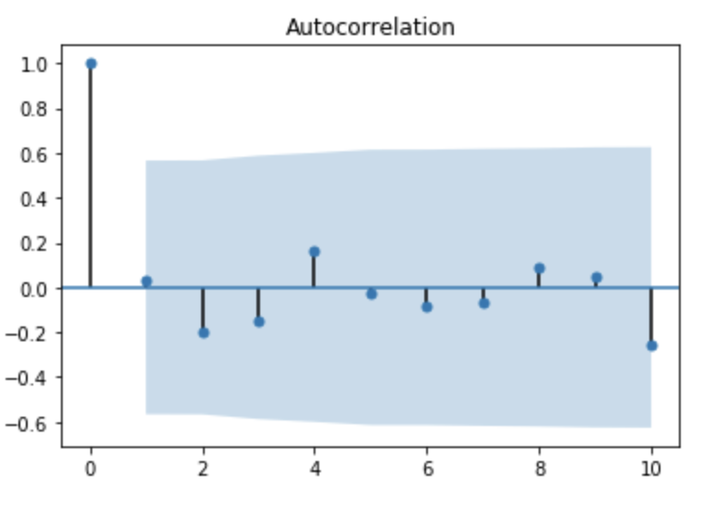
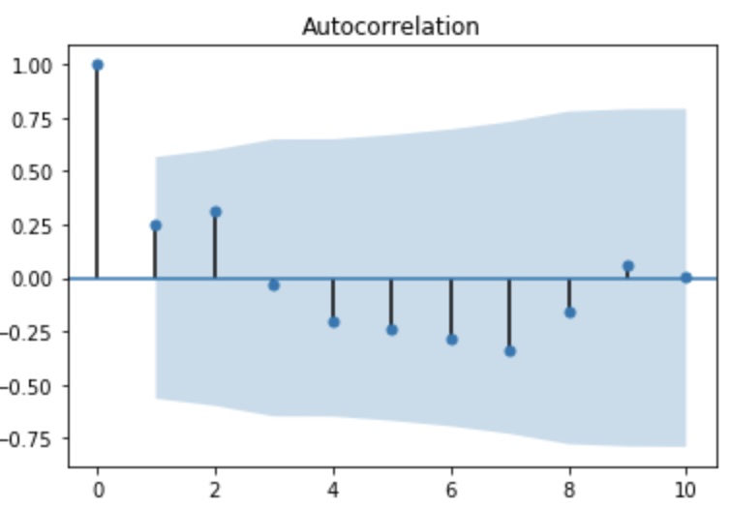
Cost-Benefit: Does spraying decrease mosquito frequency?
Mosquito Frequency
West Nile Virus
Notes:
2013-07-14 through 2013-09-29

Slide 12
Cost-Benefit Analysis: Spray Side Effects
Ataxia (uncoordinated movements)
Hyperreactivity (exaggerated reaction to stimuli)
Tremor (uncoordinated trembling or shaking movements)
Paresthesia (skin sensation of tingling, tickling, prickling)
Exhaustion (lethargy, fatigue)
Hypersalivation (drooling)
Vomit
Diarrhea
Urinary incontinence

Slide 13
Project Next Steps
Invest money in further research on the types of mosquitos that carry West Nile Virus.
Invest money into finding a vaccine for West Nile Virus.
Cost-Benefit Analysis of alternative forms of mosquito reduction.
Invest time in improving model prediction

Slide 14
Next Steps: Alternative Solutions to Spray
Bug Zapper
Mosquito Magnet/Trap

Slide 15
Questions?

Slide 16
Citations
https://www.nytimes.com/2000/04/23/nyregion/l-beware-the-side-effects-of-spraying-pesticides-892661.html
https://www.centralmosquitocontrol.com/-/media/files/centralmosquitocontrol-na/us/resources-lit%20files/zenivex%20cost%20comparison%20fact%20sheet.pdf
https://thefifthcolumnnews.com
https://parasitipedia.net/index.php?option=com_content&view=article&id=2682&Itemid=3044
Notes:
https://thefifthcolumnnews.com/2015/08/why-are-toxic-chemicals-being-sprayed-in-my-front-yard-tonight/
https://parasitipedia.net/index.php?option=com_content&view=article&id=2682&Itemid=3044

Slide 17
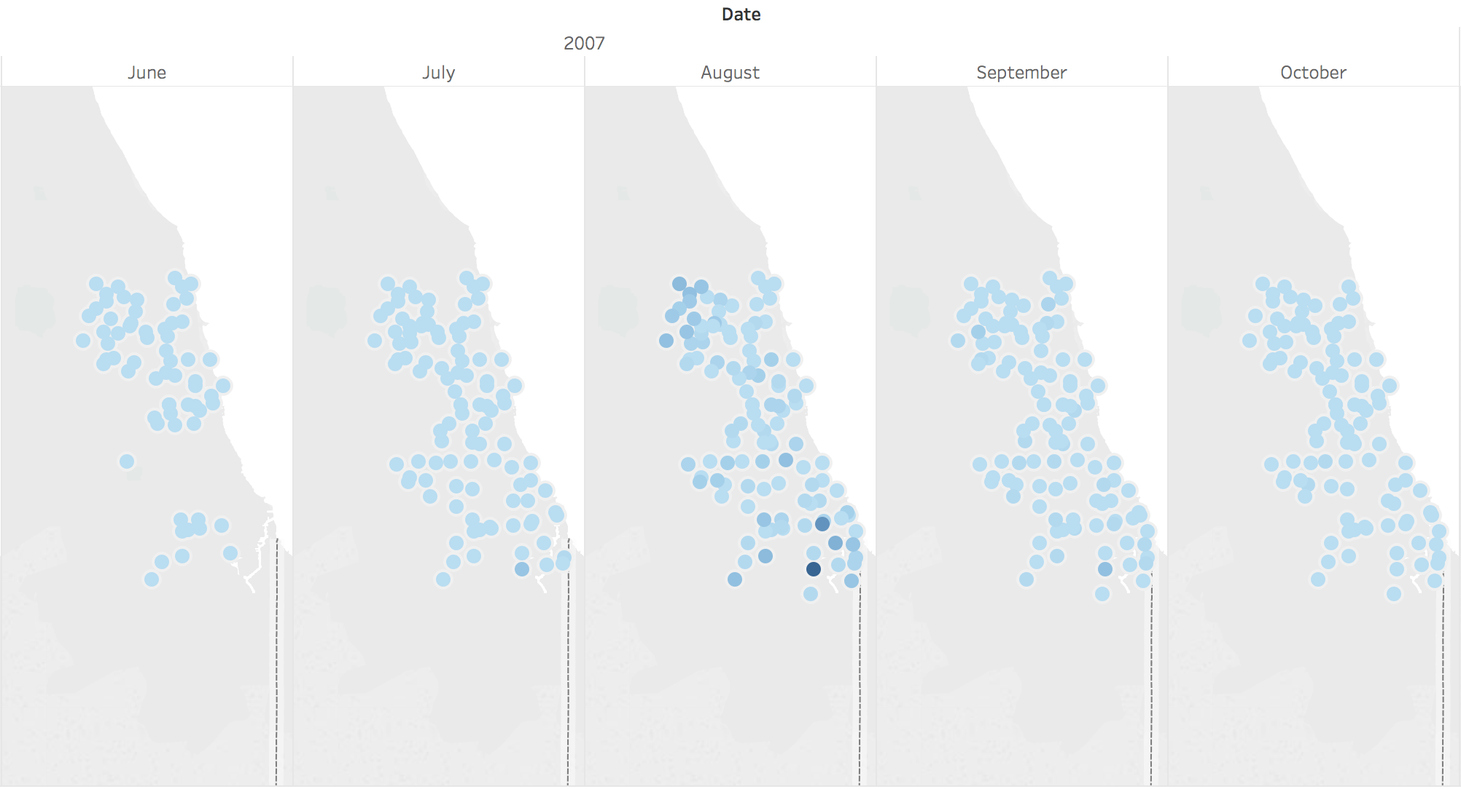
Exploring:
Where is West Nile?
Notes:
This graphic displays all of the mosquito traps in Chicago, colored by the frequency of times that mosquitos were infected with West Nile.

Slide 18
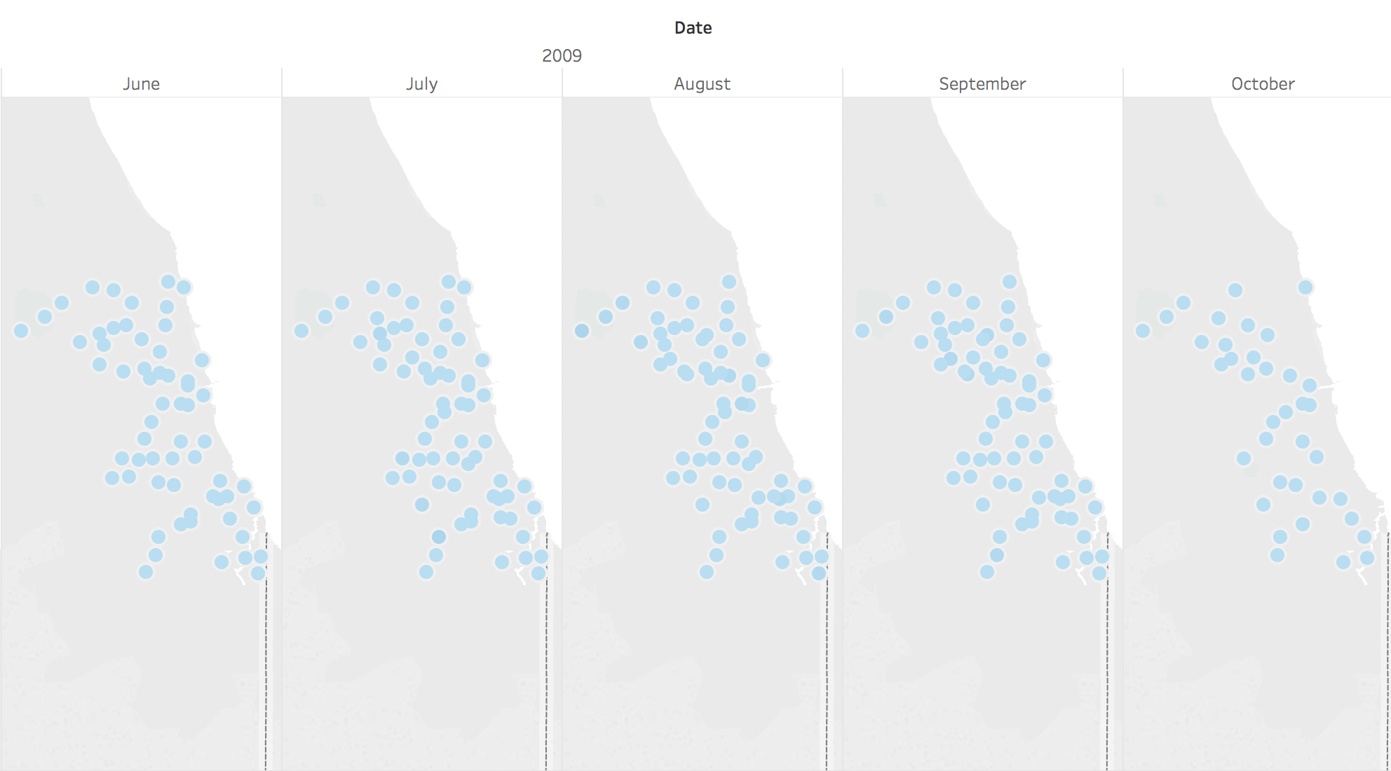
Exploring:
Where is West Nile?
Notes:
This graphic displays all of the mosquito traps in Chicago, colored by the frequency of times that mosquitos were infected with West Nile.

Slide 19
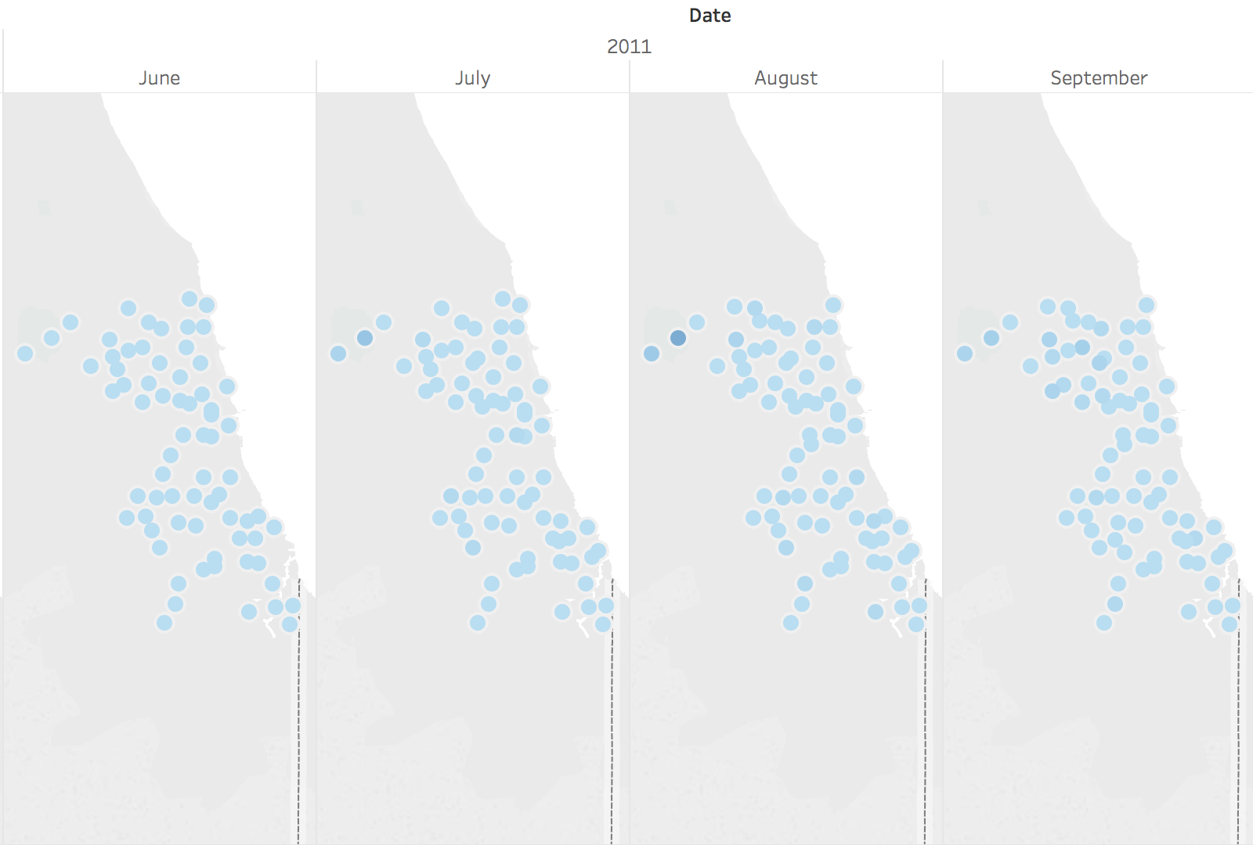
Exploring:
Where is West Nile?
Notes:
This graphic displays all of the mosquito traps in Chicago, colored by the frequency of times that mosquitos were infected with West Nile.

Slide 20
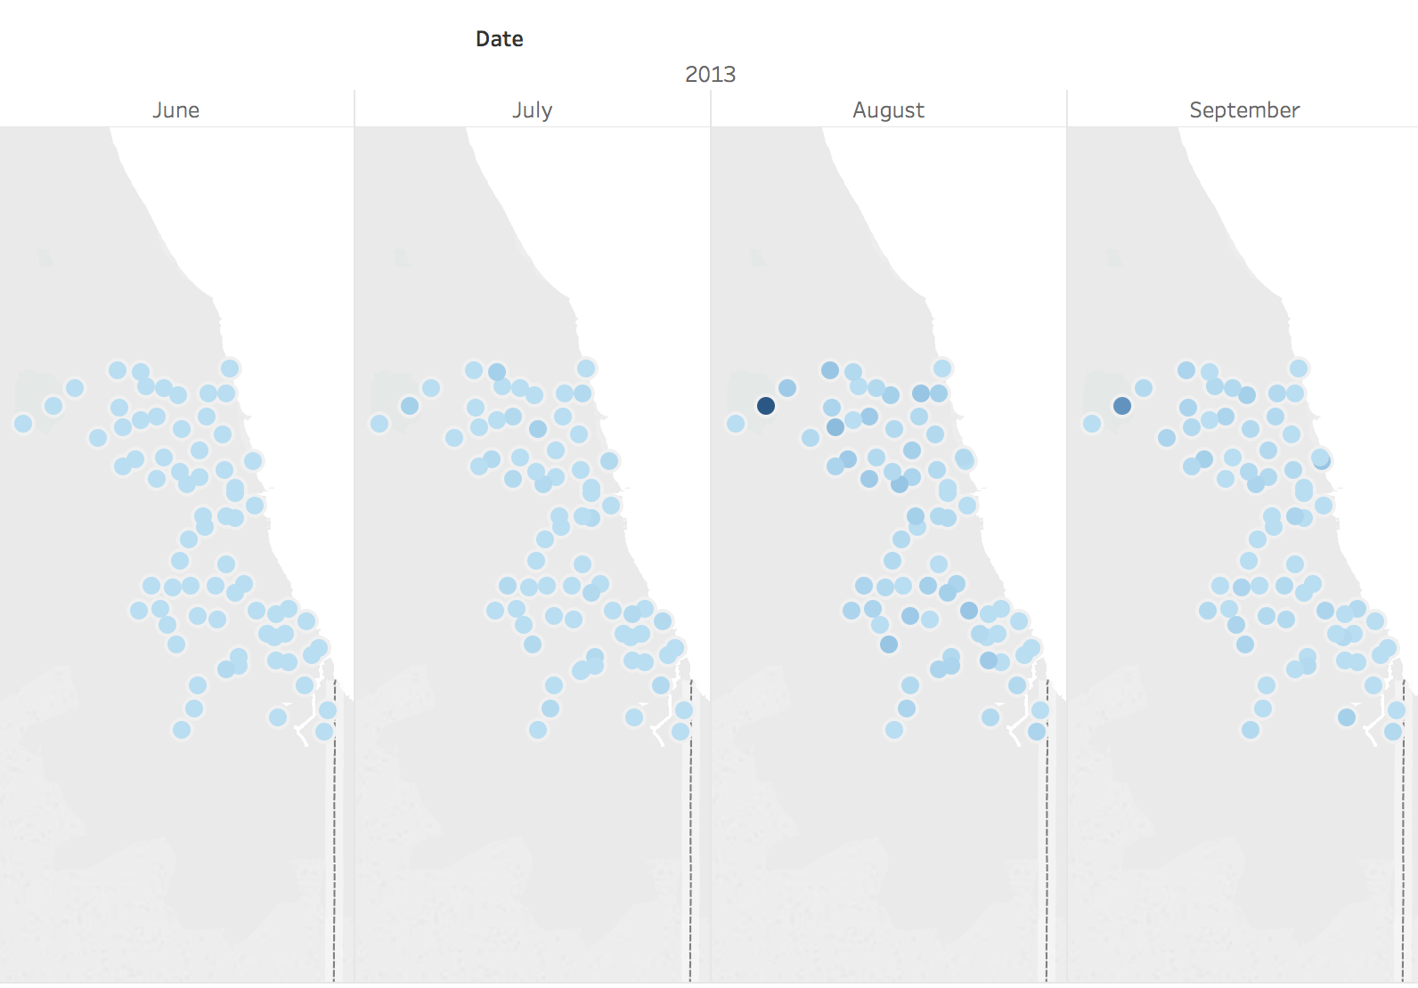
Exploring:
Where is West Nile?
Notes:
This graphic displays all of the mosquito traps in Chicago, colored by the frequency of times that mosquitos were infected with West Nile.

Slide 21
Cost-Benefit Analysis: West Nile Deaths
Year | Total Cases | Deaths
2007 | 101 | 4
2008 | 20 | 1
2009 | 5 | 0
2010 | 61 | 4
2011 | 34 | 3
2012 | 290 | 12
2013 | 117 | 12
2014 | 44 | 3

Slide 22
Cost-Benefit Analysis: West Nile Deaths
Year | Total Cases | Deaths
2007 | 101 | 4
2008 | 20 | 1
2009 | 5 | 0
2010 | 61 | 4
2011 | 34 | 3
2012 | 290 | 12
2013 | 117 | 12
2014 | 44 | 3
2015 | 77 | 9
2016 | 154 | 8
2017 | 90 | 8
2018 | 47 | 1

